Slide 1
Rewilding Planner
Liam Sullivan, Scott Styslinger

Slide 2
Did you know chopping down trees can help the environment and improve carbon capture
Chopping down trees in dense forests allows for more sunlight to come
This allows for more animals to come through and live creating a more biodiverse environment
Many of these animals bring the seeds of bushes like hemlocks on their backs which help fill the carbon capture gap left by the trees

Slide 3
What we Made
A visual planner that allows you to plot forest land and see which trees you should chop down to create a biodiverse and carbon safe environment

Slide 4
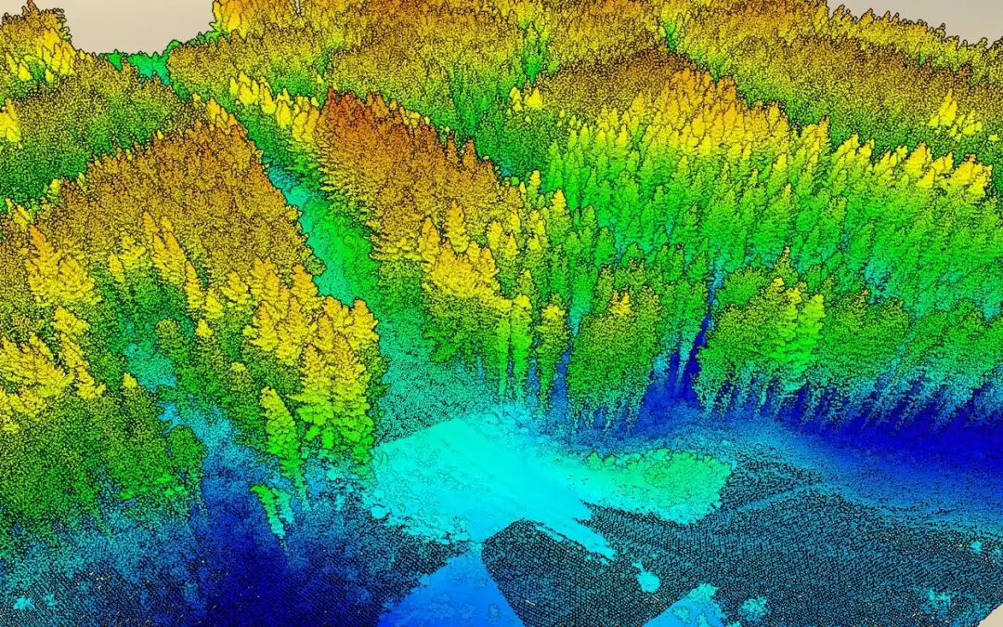
When would this be used?
Many researchers and agencies use LIDAR map forests and tree density
Rangers who wish to wild an area could import their data into our project
Then they could use the data out to map changes to make in their parks

Slide 5
How does it work
The user creates their plot of land on our website
Items on the plot are mapped by colors of an image then sent to backend
Backend scores this map, judges which trees to remove, then returns its adjusted map with a higher carbon capture and biodiversity score

Slide 6
How did we score Biodiversity and Carbon Capture
Carbon Capture(kg) = .5kg per pound of tree and bush
Tree weight(Spruce) = 1.9kg per 3cm^2
Bush weight(Hemlock) = 1.6kg per 3cm^2
Biodiversity= Difference from 4open:1water:1 shaded ratio
Bush Count= (Biodiversity score-.2)*Open Space Avaliable

Slide 7
How does judgement work
Input Maps
3x640x640
Tree removal activations(bool)
Environment Area Count
Area Scores
Tree 1
Shaded
BMP Tensor
Leaf Tensor
Stump Tensor
Tree 2
Stumps
Biodi. Score
Bush Count
Carbon Score
Tree 3
Water
Tree 4
Open Grass

Slide 8
Stack
Svelt Frontend
Flask Backend(never implemented)
Pytorch for tensor math

Slide 9
Bibliography
https://digitalcommons.library.umaine.edu/cgi/viewcontent.cgi?article=1019&context=aes_miscreports
https://research.fs.usda.gov/srs/products/compasslive/measuring-forest-structure-lidar-and-finding-right-resolution
https://besjournals.onlinelibrary.wiley.com/doi/10.1002/2688-8319.12301
https://www.itreetools.org/support/resources-overview/i-tree-methods-and-files/new-carbon-equations-and-methods-2020
https://www.biology.ox.ac.uk/article/rewilding-offers-a-carbon-capture-alternative-to-tree-plantations-with-a-wealth-of-biodivers
https://royalsocietypublishing.org/doi/10.1098/rstb.2017.0433

